Slide 1

School of Electronics Engineering (SENSE)
Project-I (2026)
Task-Aware Object Identification for Assistive Robotics using PYNQ-Z2
Student Name(s):
Shubh Gupta — 23BLC1322
Aarav Sharma — 23BLC1300
Ankush Kumar Jaiswal — 23BLC1179
Guide's Signature with Date
Guide:
Prof. Jean Jenifer Nesam J, SENSE
Signature: _____________________
Programme / School:
B.Tech — SENSE, VIT Chennai
Date: _________________________
Review & Date:
Review-III · 28.10.2026 (Wednesday)
1
Notes:
Get this slide signed by the guide, scan it and use the scanned copy as Slide 1.

Slide 2
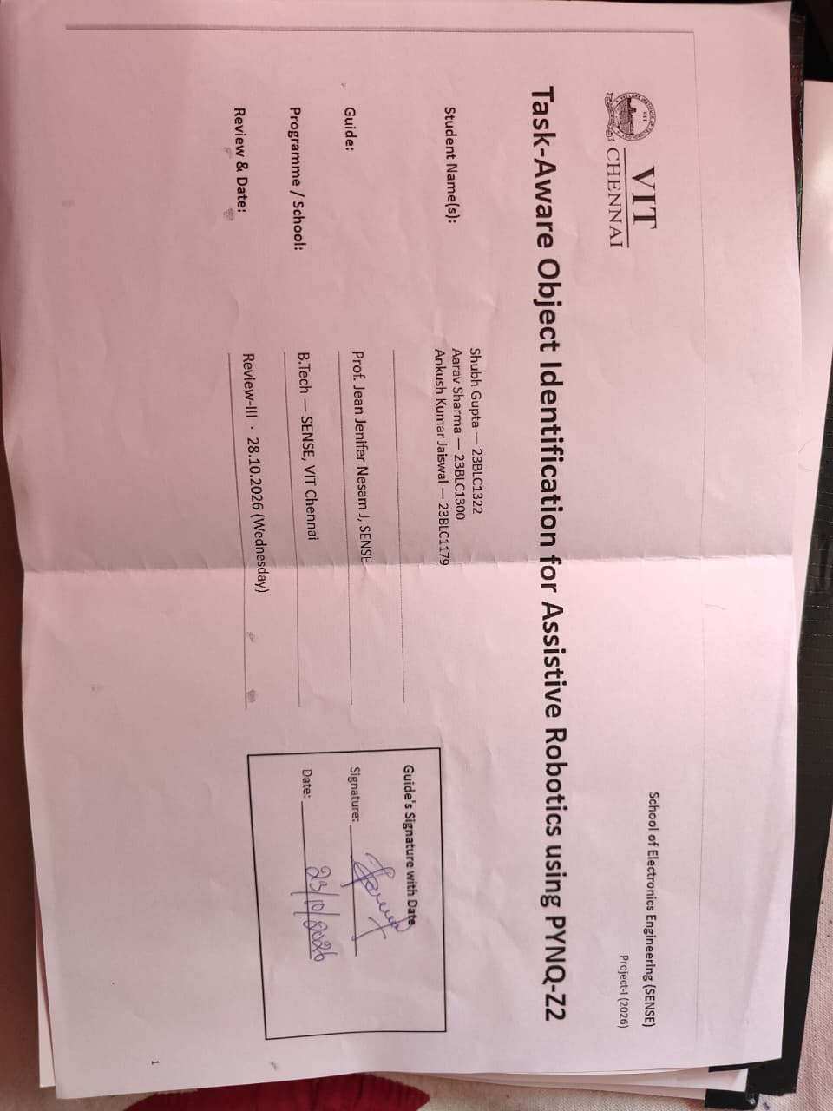

Slide 3
Project Overview & Objectives
Project overview
Objectives and their achievement
Detectors say what is in a scene; an assistive robot must decide which object fits a request.
User: “something to drink from” → robot must pick the cup, not list cup, laptop and person.
Model 1 (YOLO detector) proposes candidates; Model 2 (CLIP) ranks them against the task text.
Output: one robot-ready JSON target (class, score, box) + annotated image, on the PYNQ-Z2 edge board.
1
Detect objects with a YOLO-family detector (Model 1)
Achieved — 3 interchangeable detectors
2
Rank candidates against the task with CLIP (Model 2)
Achieved — fused crop/label/confidence score
3
Robot-ready JSON target + annotated image
Achieved — saved for every run
4
Extend to classroom and room objects
Achieved — 220-object vocab, 46-class detector
5
Run on PYNQ-Z2 with a demo interface
Pipeline ran on ARM PS; PL benchmark pending
2

Slide 4
Problem Statement & Motivation
Problem statement: given an RGB image and a free-form natural-language task, identify the single object that best satisfies the task and return it as a robot-ready target (class, confidence, score, bounding box) — on the PYNQ-Z2 edge board, without cloud services.
Users describe needs, not class names
Detectors stop at labels
“Something to drink from”, not “cup”. The robot must translate intent into an object.
FPGA YOLO accelerators optimise FPS and FPS/W but never decide which object fits a request.
Language-grounded robotics is compute-hungry
Edge deployment matters
Open-vocabulary detectors and LLM planners need GPUs or the cloud.
A home or care robot needs low latency, low power and private on-board inference.
3

Slide 5
Literature Survey
Ref. | Work | Method | Gap relevant to this project
[1], [2] | YOLO, YOLO9000 (2016–17) | Single-stage CNN detector; Tiny YOLOv2 | Fixed labels; no task reasoning
[3]–[6] | FPGA YOLOv2/v5/v6/v8 accelerators (2022–25) | Quantised / HLS / dataflow FPGA designs | Detection only, no semantic layer
[7] | FINN (2017) | Quantised NN dataflow on Zynq | No semantic reasoning
[8] | CLIP (2021) | Contrastive image–text pre-training | Heavy for edge devices
[9] | COCO-Tasks (2019) | Graph network over detections | Fixed 14-task list, GPU
[10], [11] | TOIST (2022), CoTDet (2023) | Transformer / LLM affordance prompting | Too heavy; needs large LLM
[12], [13] | OWL-ViT (2022), YOLO-World (2024) | Text-queried open-vocabulary detection | Matches names, not task intent; GPU
[14], [15] | CLIPort (2021), SayCan (2022) | Language-conditioned manipulation | GPU policy / cloud-scale LLM
4

Slide 6
Research Gaps & Our Approach
1
Task-driven detection is GPU-bound
This project addresses them
COCO-Tasks, TOIST, CoTDet [9]–[11] target desktop GPUs, not low-power FPGA boards.
YOLO detector + CLIP task ranking
Accepts any task text
Returns one JSON target with a box
Runs in Python on the PYNQ-Z2
Detector designed for the board’s programmable logic
2
FPGA YOLO accelerators stop at labels
Accelerators [3]–[7] optimise throughput but never pick the object for a need.
3
Language-grounded robotics needs heavy compute
OWL-ViT, YOLO-World, CLIPort, SayCan [12]–[15] rely on GPU or cloud.
4
No lightweight robot-ready edge pipeline
Nothing combines an embedded detector with CLIP ranking and returns one target.
5

Slide 7
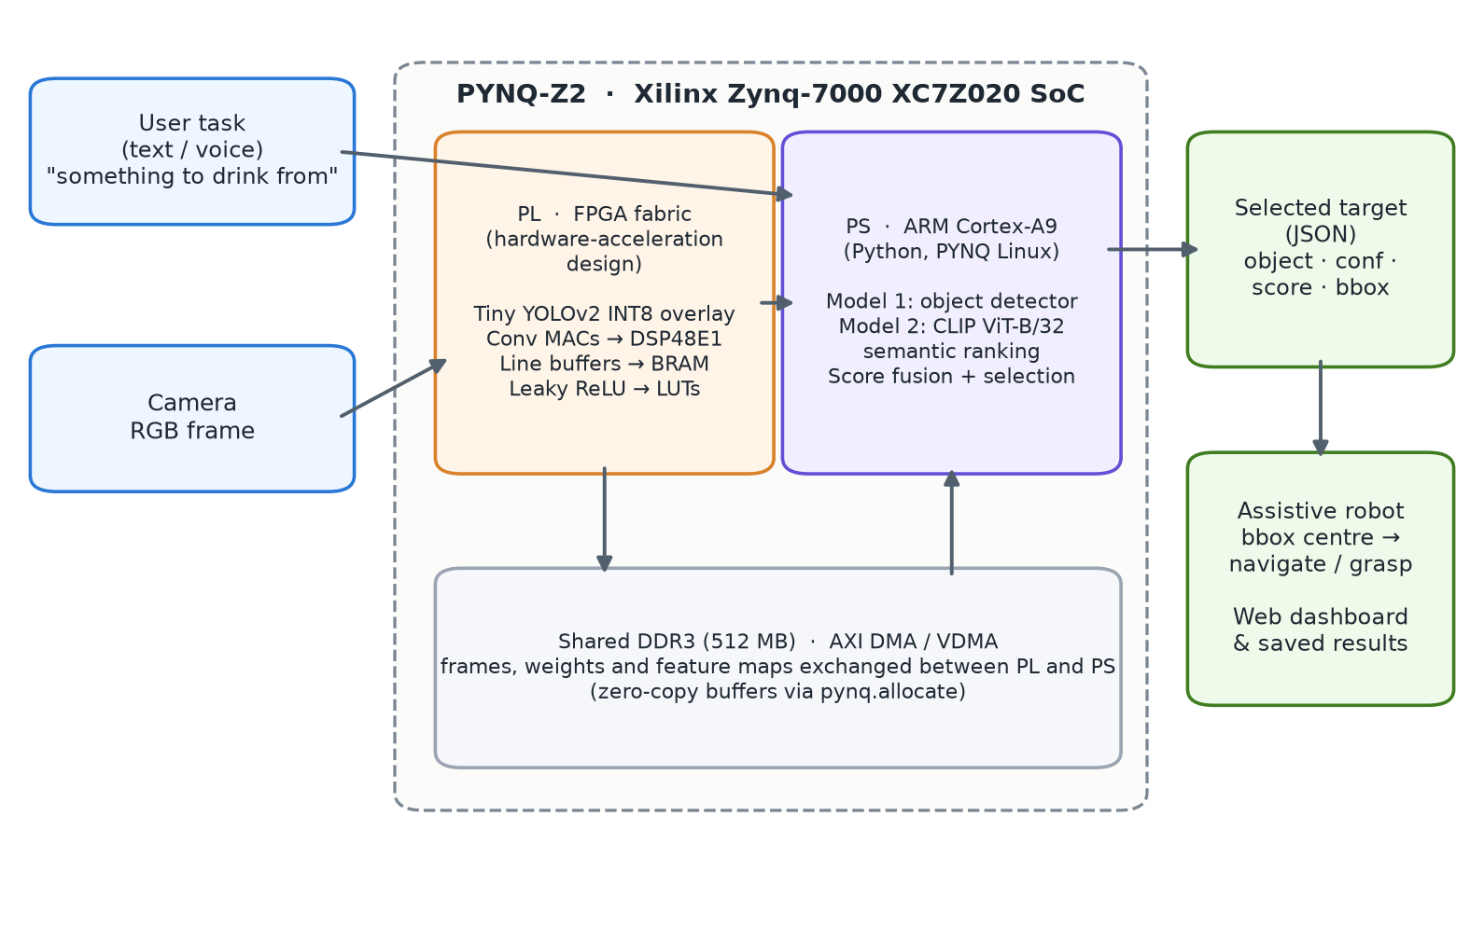
System Architecture
Input
Camera RGB frame + the user’s task as text (or speech → text).
PL — programmable logic
Detector as a Tiny YOLOv2 INT8 overlay: DSP48 MACs, BRAM line buffers, AXI VDMA.
PS — ARM Cortex-A9
Python pipeline: CLIP semantic ranking, selection, orchestration.
Output
JSON target + annotated image → robot navigates to / grasps the box centre.
System architecture on the PYNQ-Z2 (Zynq-7000 XC7Z020)
6
Notes:
Insert your final architecture / block diagram here.

Slide 8
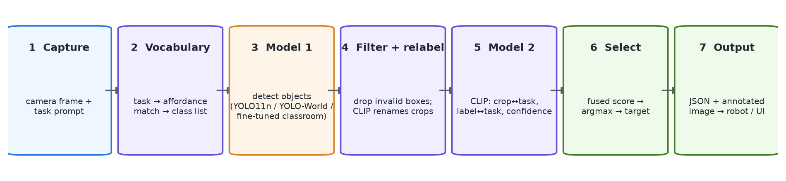
Process Work Flow & Output Format
Steps per request
{ "task": "headphones", "detector": "world",
"selected": { "class_name": "headphones",
"confidence": 0.2001, "score": 0.5257,
"bbox": [644.9, 256.0, 774.8, 469.9] },
"ranked": [ ... ], "elapsed_ms": 3611 }
result.json — box centre → robot navigation / grasp
Capture frame and task text
Open-vocab: build candidate list from the task
Run Model 1 detector
Filter boxes; CLIP re-labels open-vocab boxes
Model 2 fused task-relevance score
Select the best; save JSON + annotated image
7

Slide 9
Complete Implementation — All Modules (100%)
Model 1 option | Model | Classes | Notes
YOLO · 80 classes | YOLO11n, COCO-pretrained | 80 fixed COCO classes | ≈ 5.4 MB; ran on the board
Open-vocabulary | YOLO-World v2-S + CLIP re-labelling | Any object named in the task | Host PC only; heaviest
Fine-tuned · classroom | YOLO11n fine-tuned on Open Images | 46 classroom/room classes | 5.5 MB; suited to the board
Model 1 — Object detection
Model 2 — Task-aware ranking (CLIP ViT-B/32)
YOLO11n (COCO) — 80 classes, ran on the board at Review-II
YOLO-World open-vocabulary — any object named in the task
Fine-tuned YOLO11n — 46 classroom/room classes, 5.5 MB, ONNX/INT8-ready
Shared output format, so Model 2 works with any detector
220-object vocabulary described by use (affordances)
Hubness correction removes “match-everything” objects
score = 0.55·crop + 0.25·label + 0.20·conf; person ×0.5
CLIP re-labels open-vocabulary boxes (microphone → headphones)
8

Slide 10
Complete Implementation — Semantic Ranking in Detail
From task text to candidates
Score fusion
220 objects, each described by its use: “duster, used to erase and wipe the board clean”
Top-8 matches form the detector’s class list; person excluded unless asked
pᵢ = softmax(100·sim(t, cropᵢ)) qᵢ = softmax(100·sim(t, labelᵢ))
scoreᵢ = 0.55·pᵢ + 0.25·qᵢ + 0.20·confᵢ
person × 0.5 unless the task mentions a person
Hubness correction
Aspect | Review-II | Final
Task text | 14 fixed phrases | user’s own text
Image term weight | 35% (raw cosine) | 55% (softmax)
Confidence weight | ≈ 20%, favoured person | 20% + person penalty
Wrong labels | kept | CLIP re-labelling
sim′(t, oᵢ) = sim(t, oᵢ) − mean sim(oᵢ, oⱼ)
Stops “toy”, “book”, “cake” appearing for every task. Mapping 10/14 → 14/14.
9

Slide 11
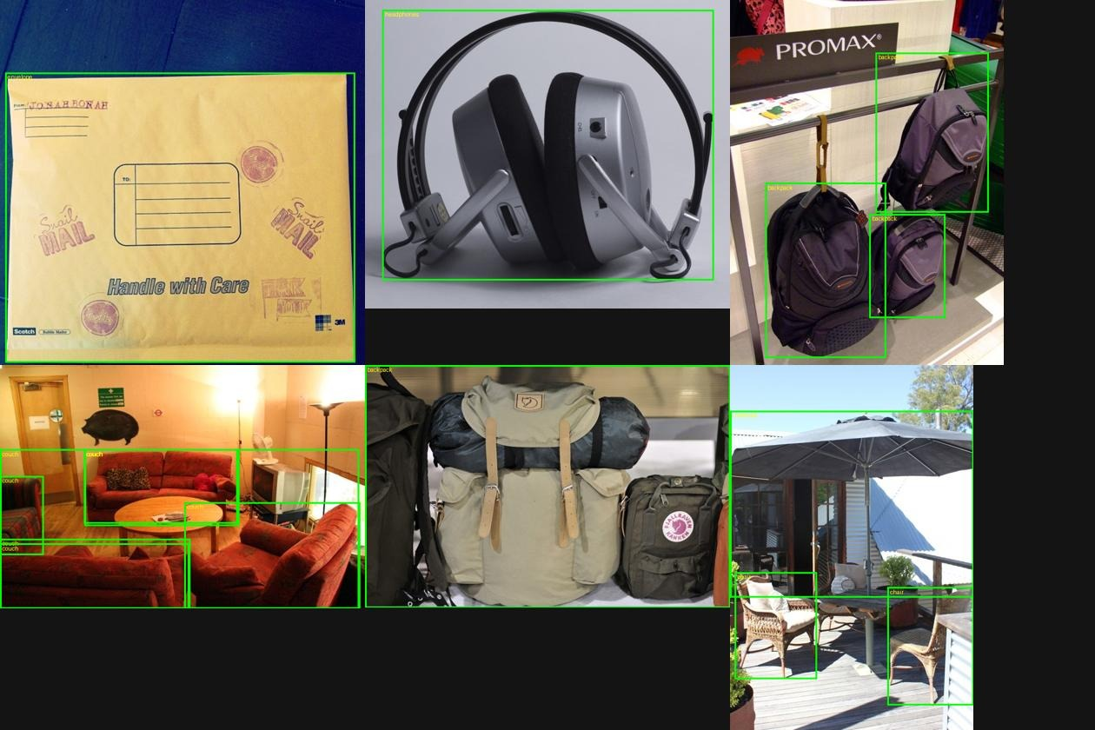
Complete Implementation — Classroom Dataset & Fine-Tuning
Dataset | Value
Source | Open Images val + test (verified boxes)
Classes | 46 classroom / room objects
Images | 1,342 (1,167 train · 175 held-out)
Split | MD5 hash of image ID, 15% val
Training | Run 1 (CPU) | Run 2 (GPU) ✓
Image size | 416 px | 640 px
Batch / frozen | 16 / backbone | 6 / none
Learning rate | 0.005 cosine | 0.01 cosine
Best epoch | 8 of 20 | 18 of 34
mAP50 | 51.8% | 53.1%
Open Images training samples with their boxes
10

Slide 12
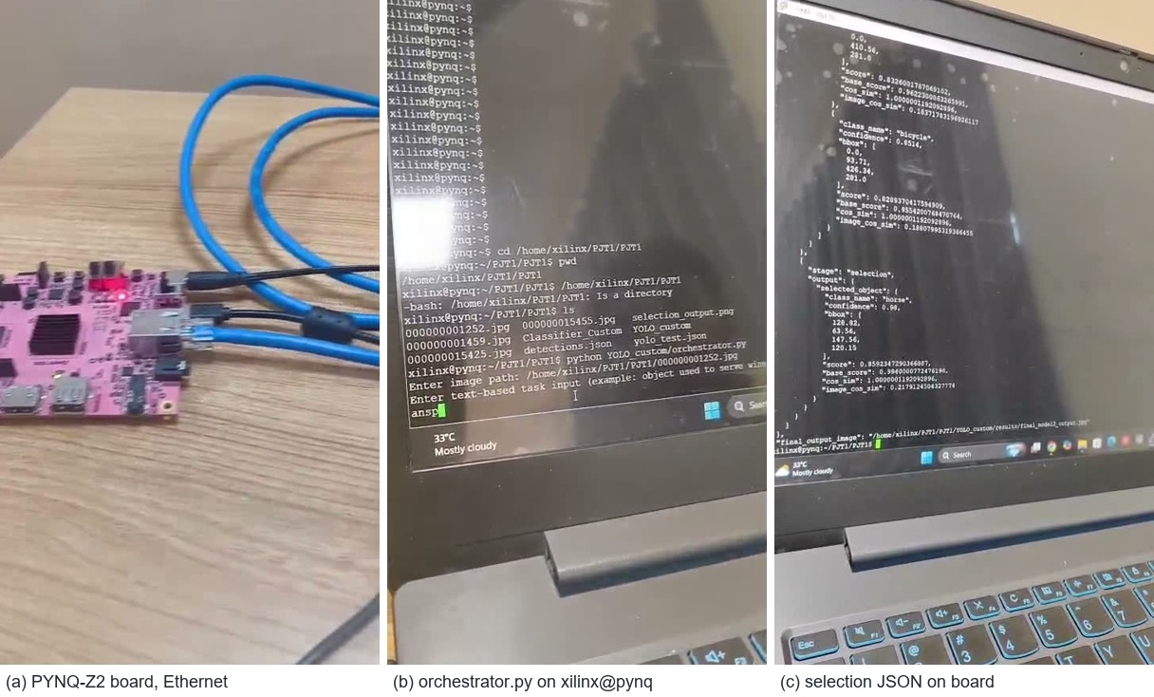
Complete Implementation — PYNQ-Z2 & On-Board Execution
Resource | Role in the design
ARM Cortex-A9 ×2 (PS) | Python pipeline, CLIP ranking
53,200 LUTs | Activations, control logic
220 DSP48E1 | Convolution MACs
140 × 36 Kb BRAM | Line buffers, weights
512 MB DDR3 | Frames, results (AXI DMA)
Ethernet · USB-UART | SSH / Jupyter, serial
Hardware path
Full pipeline executed on the ARM PS via SSH
PL: Tiny YOLOv2 INT8 overlay via AXI VDMA
Target ≈ 30 FPS within < 15 W
(a) PYNQ-Z2 over Ethernet · (b) orchestrator.py in xilinx@pynq · (c) JSON on board
11

Slide 13
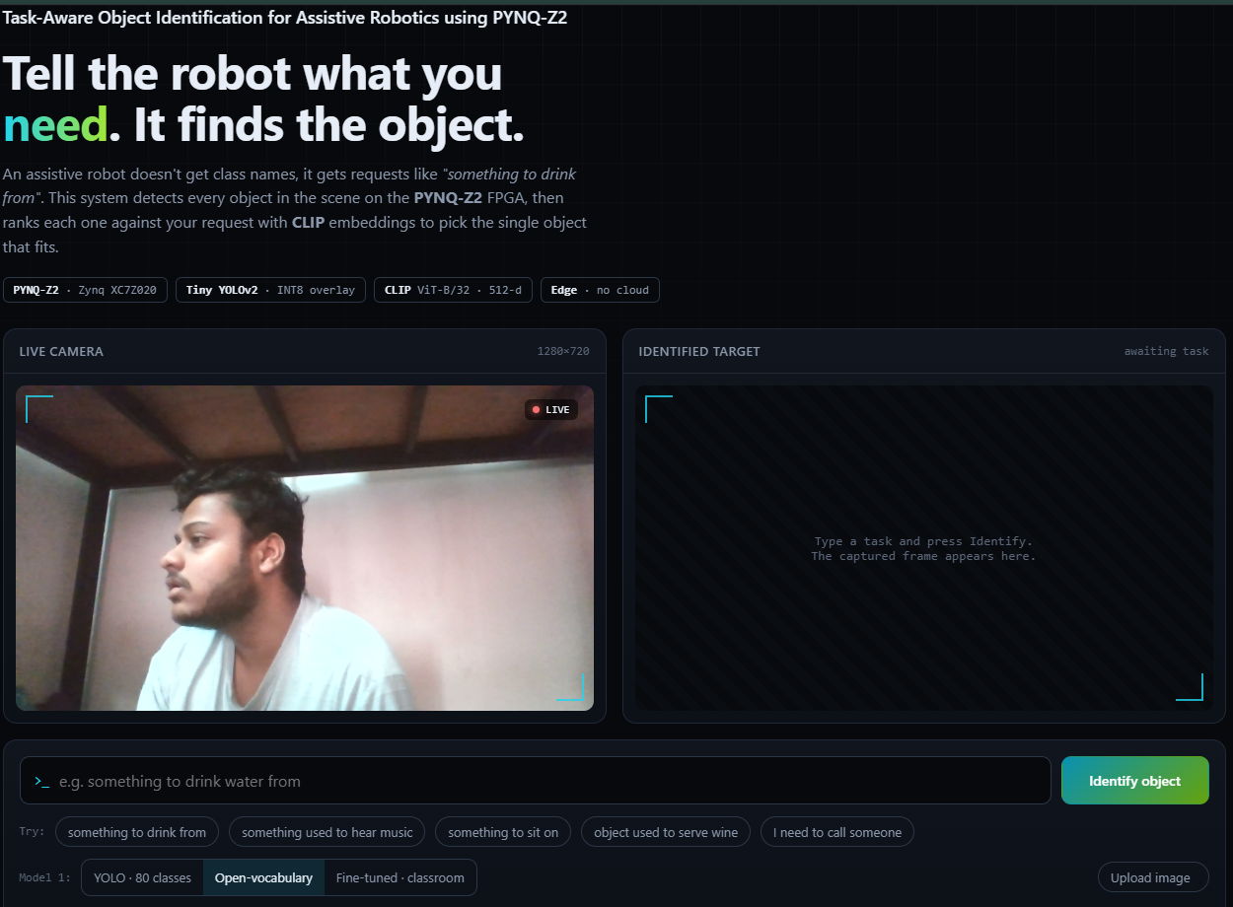
Complete Implementation — Integration & Optimisation
Integration details
Three front-ends on one pipeline: OpenCV camera UI (MIL tracker), PuTTY/SSH bridge, web dashboard
Every run auto-saved (input, annotated image, result.json)
Live PYNQ-Z2 connection indicator (Ethernet / USB-UART)
Performance optimisation
Issue | Before | After
Open-vocab request | ≈ 10 s | 2–4 s (cached CLIP text)
GPU training epoch | 4 min | ≈ 1 min (batch 6)
Live video | froze | smooth (background thread)
Box on moving object | drifted | tracked (MIL tracker)
Web dashboard: live camera and identified target
12

Slide 14
Challenges & Solutions
Problem | Cause | Solution
Always selected person | Fixed task phrases; confidence-heavy score | User’s own text; crop term dominant; person penalty
Headphones never found | Not a COCO class (seen as “hair drier”) | Open-vocabulary detector with task-derived classes
Headphones labelled microphone | YOLO-World confuses similar names | CLIP re-labelling of each box
Tasks mapped to wrong objects | Bare names; “hub” objects in every list | Affordance descriptions + hubness correction
Open-vocab request ≈ 10 s | CLIP text model reloaded every request | Cached encoder and vocabulary (2–4 s)
Box drifted on live video | Box drawn at fixed pixels | Background inference + MIL tracker
GPU out of memory, 4 min/epoch | Batch 16 at 640 px > 4 GB | Batch 6 (≈ 1 min/epoch)
Training crashed at epoch 34 | Windows paging file exhausted | Best checkpoint (epoch 18) deployed
13

Slide 15
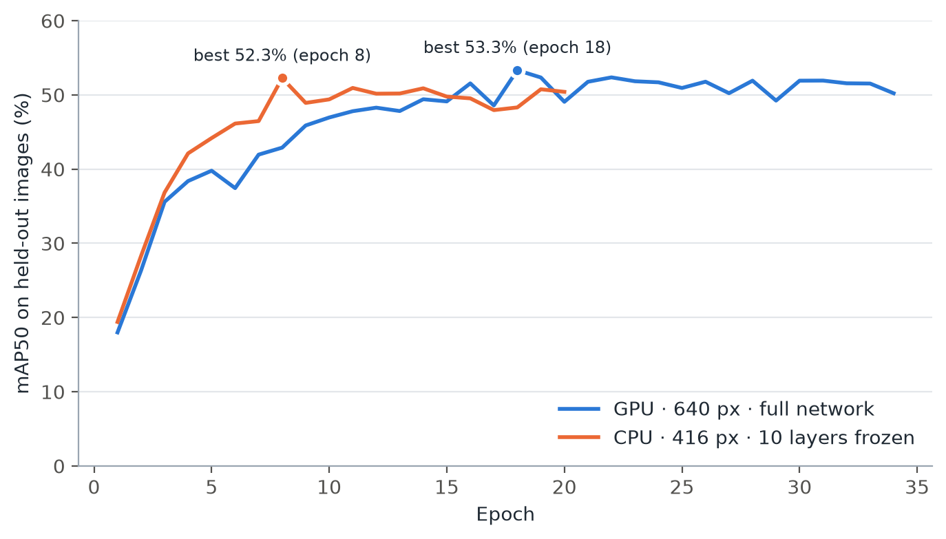
Results & Testing — Classroom Detector
53.1%
40.6%
46
1,342
mAP50 (held-out)
mAP50-95
classroom & room classes
training + validation images
Best classes | AP50 | Worst classes | AP50
lamp | 99.5% | window | 5.1%
light switch | 99.5% | desk | 5.4%
mouse | 99.5% | box | 10.8%
envelope | 99.5% | microphone | 11.7%
ceiling fan | 94.5% | table | 14.8%
Compact, distinctive objects are near-perfect; large, context-dependent ones (desk, window, table) are weak because they are often unlabelled in Open Images.
Validation mAP50 per epoch — CPU vs GPU run
14
Notes:
Add your results here — graphs, tables, screenshots or outputs.

Slide 16
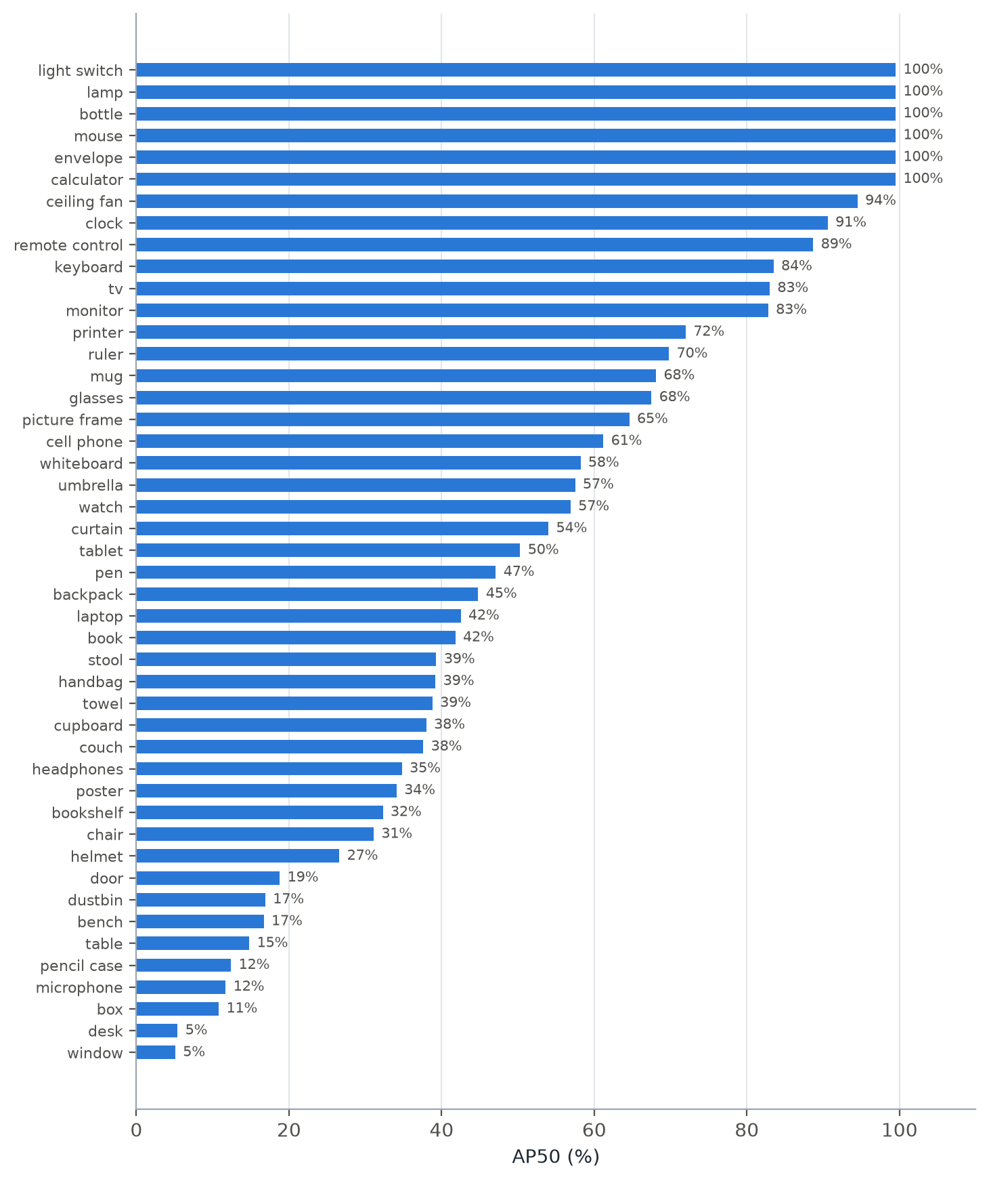
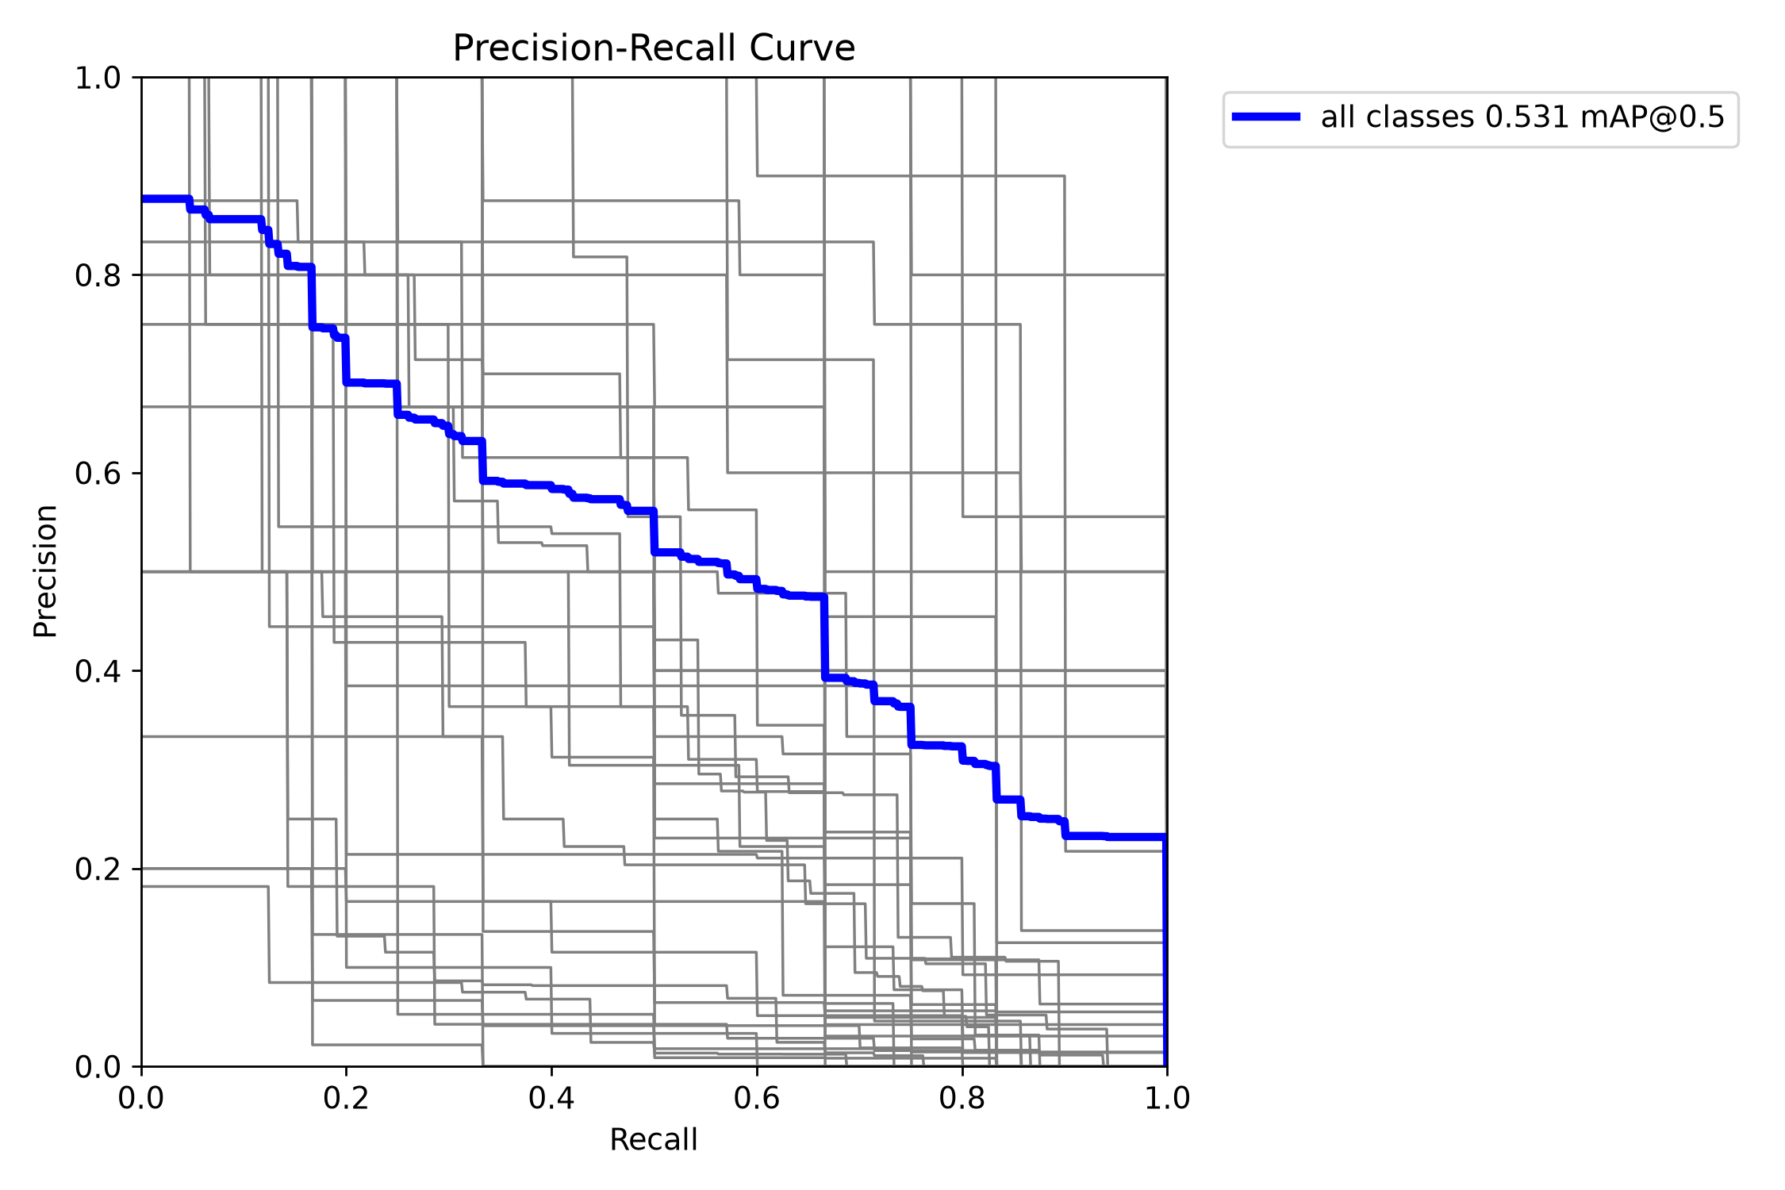
Results & Testing — Per-Class Accuracy
Precision–recall curves (thick: mean)
Calculator, envelope, mouse, bottle, lamp, light switch, ceiling fan: AP50 > 94%. Desk, window, door, table, box, bench: < 20% — large, ambiguous, often unlabelled.
AP50 for all 46 classes
15

Slide 17
Results & Testing — Task Mapping & End-to-End
28 / 28
10 / 12
1.2 s
task prompts mapped (top-1: 15 · top-3: 24)
real-world requests correct
per request, classroom detector
Headphones case: “something used to hear music”
Median time per request (host CPU)
Stage | Review-II | Final
Detector | person · “hair drier” | box on headphones
Task used | “step on something” | user’s own text
CLIP re-label | — | microphone → headphones
Selected | person ✗ | headphones ✓
Model 1 option | Time | On board
YOLO · 80 classes | 1.8 s | Yes — ran at Review-II
Open-vocabulary | 4.4 s | No — host only
Fine-tuned classroom | 1.2 s | Designed (ONNX/INT8)
Prompts were written by the team, so these are representative requests, not an independent benchmark.
16

Slide 18
Results & Testing — Task-to-Object Mapping (28 Prompts)
Everyday tasks | Expected | Rank
something used to hear music | headphones | 3
I want to listen to music | headphones | 3
something to dry my hands | towel | 2
something to drink from | cup | 1
something to sit on | chair | 6
I need to call someone | cell phone | 1
object used to serve wine | wine glass | 1
something to cut paper | scissors | 1
I want to read something | book | 1
something to tell the time | clock | 2
I want to brush my teeth | toothbrush | 1
something to write with | pen | 1
I need to see clearly | glasses | 1
something to carry my things | backpack | 4
Classroom tasks | Expected | Rank
something to erase the board | duster | 1
write on the wall for teaching | whiteboard | 1
something to show slides | projector | 4
something to measure a line | ruler | 1
something to sharpen my pencil | sharpener | 1
something to rub out a mistake | eraser | 8
something to print documents | printer | 1
something to store files | pen drive | 2
something to show my identity | id card | 1
something to cool the room | ceiling fan | 2
protect my head while riding | helmet | 1
something to clean my hands | hand sanitizer | 2
something to put my books on | bookshelf | 2
a place to sit and study | desk | 2
All 28 expected objects reach the 8-object candidate list · rank 1 for 15 · top-3 for 24. Model 2 makes the final choice from the image.
17

Slide 19
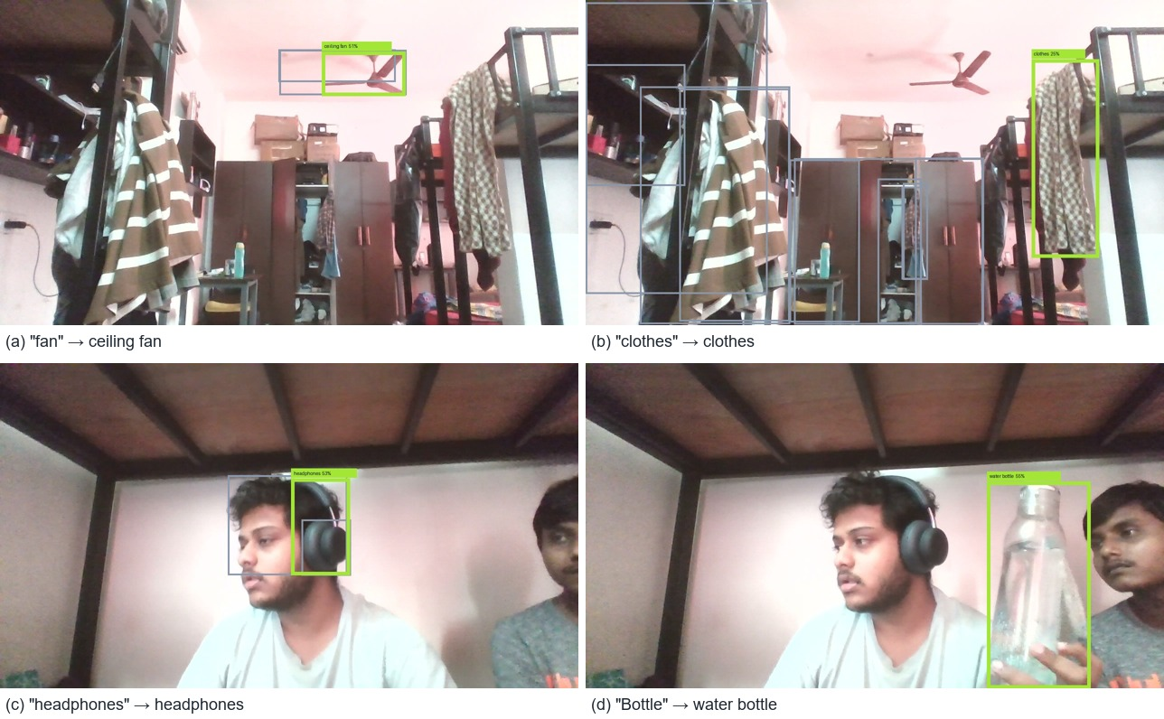
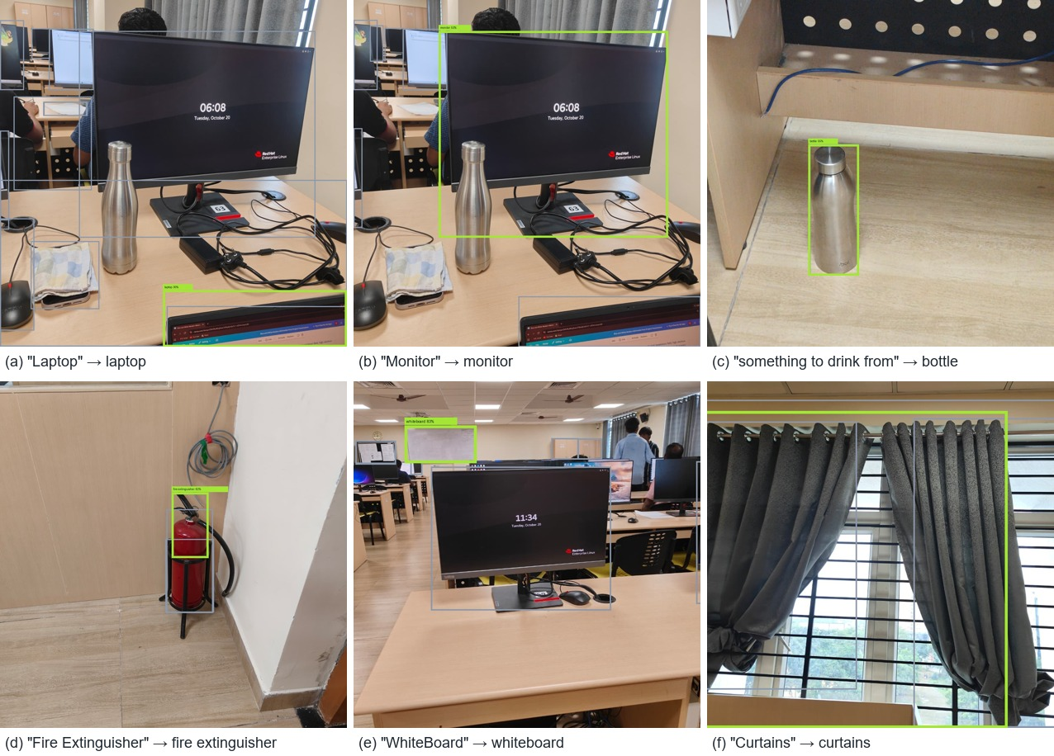
Results & Testing — Real-World Scenes
Computer lab & classroom photographs
Hostel room, live webcam: fan, clothes, headphones, bottle — all correct
10 of 12 correct. Fire extinguisher found although not in the vocabulary. Failures: ceiling fan boxed but re-labelled “microphone”; “hair” not detected.
18

Slide 20
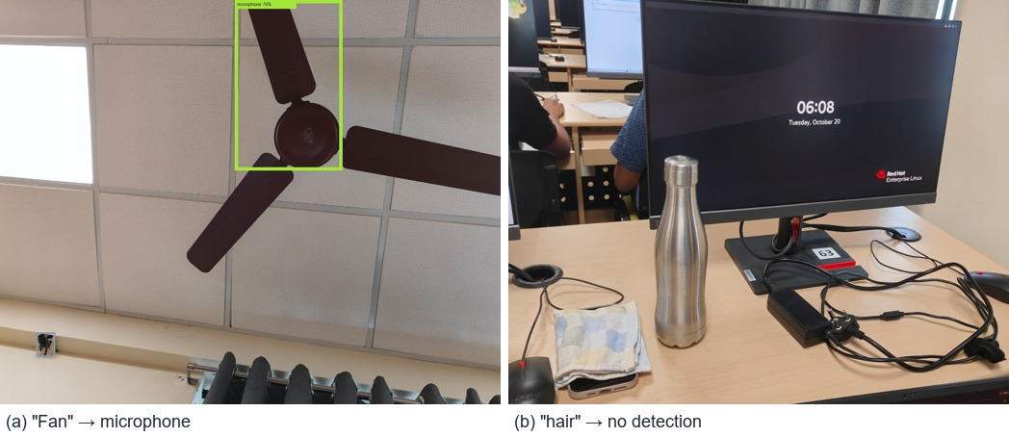
Results — Failure Cases & Discussion
Image crop is the strongest signal
Making it dominant removed the person bias.
Describe objects by their use
Affordances + hubness: 10/14 → 14/14, generalised to 28.
(a) fan boxed, re-labelled “microphone” · (b) no detection for “hair”
Open vocabulary widens coverage
Tight crop of the fan hub looks like a microphone head → widen crops before re-labelling
“someone digs hole” → person selected: the needed object (shovel) is not visible
Domain gap: headphones scored 0.017 on one webcam frame
Headphones, curtains, fire extinguisher — but ~3.5× slower, host only.
Fine-tuning gives a deployable model
53.1% mAP50, 5.5 MB, ONNX/INT8-ready for the PL.
19

Slide 21
Results — Comparison with Existing Solutions
Approach | Input | Free-form task text | Objects outside a fixed list | One robot-ready target | Runs on embedded board
YOLO / Tiny YOLOv2 [1], [2] | Image | No | No | No — list of labels | Partly (tiny variants)
FPGA YOLO accelerators [3]–[7] | Image | No | No | No — list of labels | Yes
COCO-Tasks [9], TOIST [10] | Image + 1 of 14 tasks | No | No | Yes | No — GPU
CoTDet [11] | Image + 1 of 14 tasks | No | No | Yes | No — GPU + LLM
OWL-ViT [12], YOLO-World [13] | Image + object names | No — names only | Yes | No — all matches | No — GPU
CLIPort [14], SayCan [15] | Image + instruction | Yes | Partly | Action policy | No — GPU / cloud
This work | Image + any task text | Yes | Yes | Yes — JSON + box | Yes — ran on PYNQ-Z2
[9]–[11] report accuracy on the COCO-Tasks benchmark, which was not used here, so the comparison is on capability rather than a shared accuracy number.
20
Notes:
Add your results here — graphs, tables, screenshots or outputs.

Slide 22
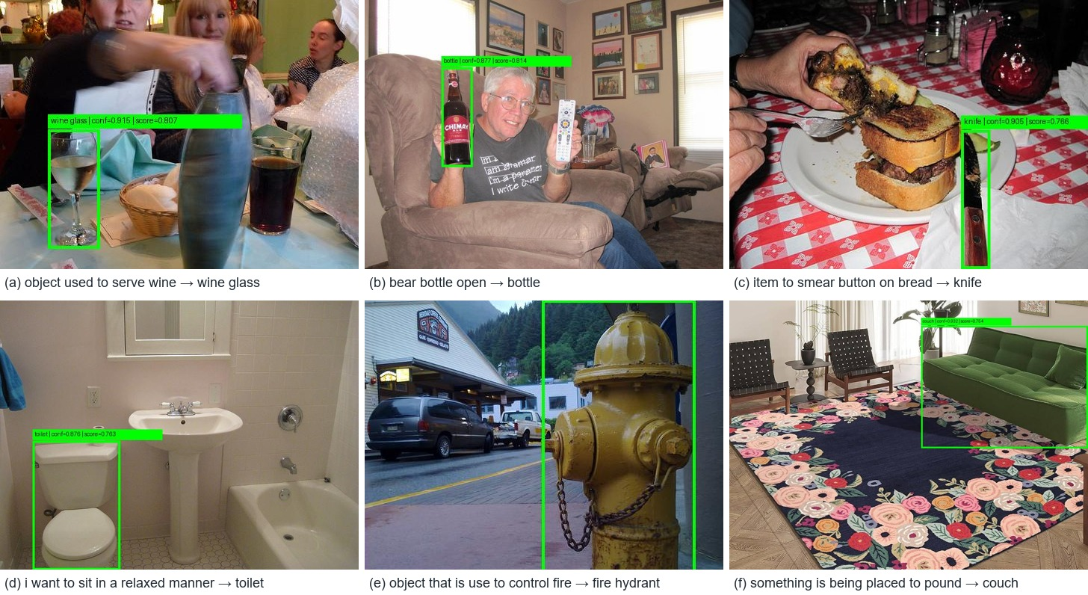
Results — Final System vs Review-II Baseline
Measure | Review-II | Final
Task representation | 14 fixed phrases | user’s own text
Prompt mapping (orig. 14) | 10 / 14 | 14 / 14
Prompt mapping (all 28) | — | 28 / 28
Objects outside COCO | not detectable | detected
Headphones case | person | headphones
Real-world requests | — | 10 / 12
Classroom detector | none | 53.1% mAP50
Open-vocab request | ≈ 10 s | 2–4 s
Review-II test set: label-level reasoning picked person / toilet for some tasks
21

Slide 23
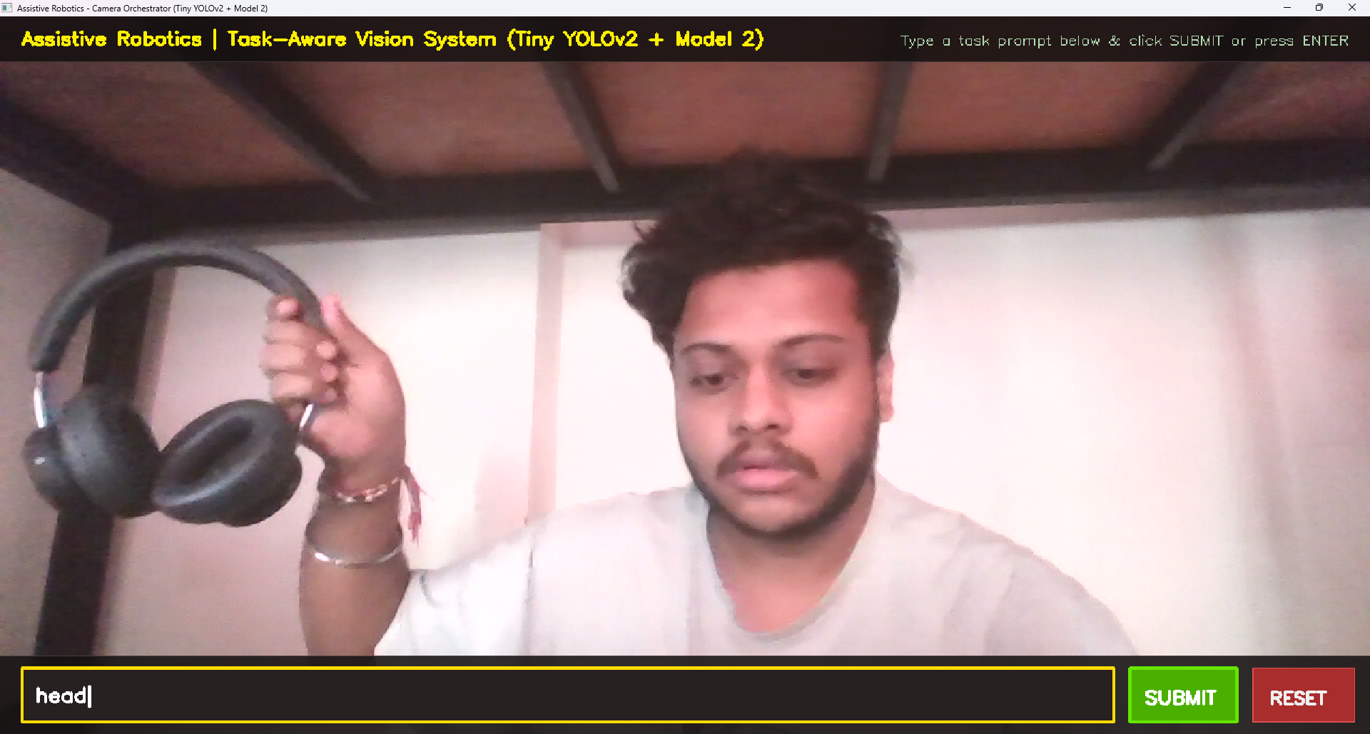
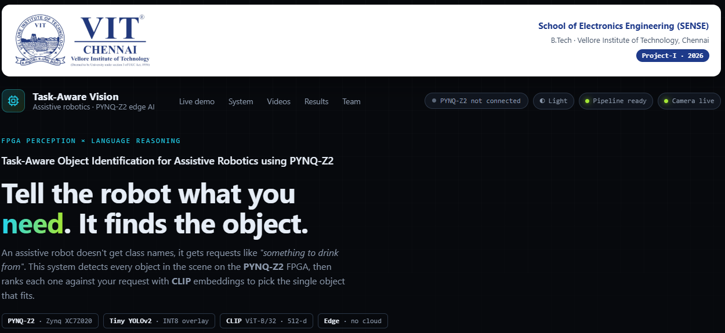
Live & Video Demonstration
Live demonstration plan
Start the dashboard; show the PYNQ-Z2 indicator turn green over Ethernet
Live webcam: ask “something to drink from” → bottle selected
Switch detectors (COCO / open-vocabulary / classroom) and read the ranking log
Run orchestrator.py on the board through PuTTY → JSON target printed
Show saved results and the results charts
Desktop camera UI with task box
Video demonstration: four recordings of the on-board run are embedded in the dashboard’s Videos section (backup if the live board link fails).
Dashboard header with board connection indicator
22

Slide 24
Standards Contributed & SDG Mapping
Standards followed
SDG mapping
ISO/IEC 22989, 23053, 23894 — AI terms, ML life cycle, AI risk
ISO 13482 — safety of personal care robots
IEEE 1149.1 (JTAG) · AMBA AXI4 — board programming, PS–PL link
IEEE 1364/1800 HDL · IEEE 754 — PL design, FP32 vs INT8
IEEE 802.3 · RFC 4253 SSH · RFC 9110 HTTP
RFC 8259 JSON · ONNX — result and model formats
ISO/IEC 27001 · IEC 62368-1 — data security, equipment safety
SDG 3
Good Health & Well-being
Helps elderly and mobility-impaired people fetch everyday objects
SDG 10
Reduced Inequalities
Natural-language control and low-cost hardware widen access
SDG 9
Industry, Innovation & Infrastructure
Language-driven perception on a low-power FPGA board
SDG 4
Quality Education
46-class classroom detector for teaching-aid robots
23

Slide 25
Conclusion & Future Scope
Conclusion
Future scope
A natural-language request becomes one robot-ready target
Person bias removed; task mapping 28/28; 10/12 real-world requests correct
46-class classroom detector at 53.1% mAP50, ready for board deployment
Pipeline executed on the PYNQ-Z2 ARM processor; PL accelerator designed
Deploy the INT8 detector as the PL overlay; report FPS, power, LUT/DSP/BRAM
Live camera over AXI VDMA with HDMI output
Dashboard “board mode” with on-board timing
Label local classroom images to close the domain gap
Confidence gate + robot arm/navigation demo
Speech input for spoken requests
24

Slide 26
References
[1] J. Redmon et al., “You Only Look Once,” CVPR, 2016.
[2] J. Redmon, A. Farhadi, “YOLO9000,” CVPR, 2017.
[3] Z. Yan et al., “FPGA-based YOLOv5 accelerator,” Micromachines, 2024.
[4] E. Emmanuel et al., “FPGA YOLOv8 using Vivado HLS,” AIBThings, 2024.
[5] X. Sha et al., “FPGA-based YOLOv6 accelerator,” IEICE Trans., 2025.
[6] Z. Zhang et al., “Resource-constrained FPGA YOLOv2,” Neural Comput. Appl., 2022.
[7] Y. Umuroglu et al., “FINN,” ACM/SIGDA FPGA, 2017.
[8] A. Radford et al., “Learning transferable visual models (CLIP),” ICML, 2021.
[9] J. Sawatzky et al., “What object should I use?,” CVPR, 2019.
[10] P. Li et al., “TOIST,” NeurIPS, 2022.
[11] J. Tang et al., “CoTDet,” ICCV, 2023.
[12] M. Minderer et al., “Simple open-vocabulary detection (OWL-ViT),” ECCV, 2022.
[13] T. Cheng et al., “YOLO-World,” CVPR, 2024.
[14] M. Shridhar et al., “CLIPort,” CoRL, 2021.
[15] M. Ahn et al., “Do as I can, not as I say (SayCan),” CoRL, 2022.
[16] G. Jocher, J. Qiu, “Ultralytics YOLO11,” 2024.
[17] A. Kuznetsova et al., “Open Images Dataset V4,” IJCV, 2020.
[18] T.-Y. Lin et al., “Microsoft COCO,” ECCV, 2014.
[19] M. Radovanović et al., “Hubs in space,” JMLR, 2010.
[20] AMD/Xilinx, “PYNQ: Python Productivity for Zynq.”
[21] TUL Corp., “PYNQ-Z2 Reference Manual.”
[22] G. Ilharco et al., “OpenCLIP,” Zenodo, 2021.
Full IEEE-format entries are in the project report bibliography.
25

Slide 27
Thank You
Shubh Gupta · Aarav Sharma · Ankush Kumar Jaiswal | Project-I (2026) · SENSE · VIT Chennai
Questions?
26

